Slide 1
"Soap, soap, my daily foe
Never ends the constant scrubbing
Feeling like a prune"
"Soap, soap, my shower nemesis
Slippery and slimy, hard to hold
Why must you haunt me?”
"Soap, soap, my bathroom enemy
Leaves me feeling fragrant and fresh
But also covered in suds”
"Soap, soap, my shower friend
Lathering up in the bath
Leaves me feeling like a slippery fish”
"Soap, soap, my bathroom partner
Washing away the stains of life
Leaves me feeling fresh and clean
But also like a walking bar of soap”
"Clean and bright, my daily friend
Washing away the dirt and grime
Leaves my skin so pure"
"My faithful ally, lathering up
Scrubbing away the stains of life
Leaving me feeling brand new"
"Floating free, the soap bubbles fill
Filling up the bath with joy
Splashing, laughing fun”
Lather, Rinse, Repeat:
ChatGPT's Soapy Haikus
Soap in the shower, slip
I almost fell, but I grip
Leaves me feeling clean and hip
Soap on my face, scrub
Removing dirt and grime, I dub
Myself the queen of the tub
The scent of soap fresh
Bringing memories of my ex
I wash away the stress
Soap, a daily need
But don't get too close, I plead
I'm still covered in soap suds, indeed
A bar of soap small
But it's got the power to stand tall
Leaves me feeling brand new, after all
Soap in the sink, wet
Uncovering hidden grime
Leaves the dishes clean, you bet
Soap, a small luxury
But it's got the power to be
My favorite thing, you see.

Slide 2
Stained shirt in the sink
Brings back memories of that drink
Washed away now clean
Lather, Rinse, Repeat:
ChatGPT's Soapy Haikus
Soapy water swooshes
Scrub scrub scrub until it's done
Laundry day is fun
Water drips and splashes
As I scrub away the stains
Washing day at last
Laundry piles high
I'll wash them all before I die
Washing day never ends
Laundry basket full
Of stinky socks and dirty clothes
Washing day is tough

Slide 3

Stained shirt in the sink
Brings back memories of that drink
Washed away now clean
Soap in the shower, slip
I almost fell, but I grip
Leaves me feeling clean and hip
Soap on my face, scrub
Removing dirt and grime, I dub
Myself the queen of the tub
The scent of soap fresh
Bringing memories of my ex
I wash away the stress
Stained shirt in the sink
Brings back memories of that drink
Washed away now clean
Soap, soap, my shower nemesis
Slippery and slimy, hard to hold
Why must you haunt me?
Soap, soap, my daily foe
Never ends the constant scrubbing
Feeling like a prune
Stained shirt in the sink
Brings back memories of that drink
Washed away now clean
Soap in the shower, slip
I almost fell, but I grip
Leaves me feeling clean and hip
Soap on my face, scrub
Removing dirt and grime, I dub
Myself the queen of the tub
The scent of soap fresh
Bringing memories of my ex
I wash away the stress
Stained shirt in the sink
Brings back memories of that drink
Washed away now clean
Soap, soap, my shower nemesis
Slippery and slimy, hard to hold
Why must you haunt me?
Soap, soap, my daily foe
Never ends the constant scrubbing
Feeling like a prune
Lather, Rinse, Repeat:
ChatGPT's Soapy Haikus
Lather, Rinse, Repeat:
ChatGPT's Soapy Haikus

Slide 4
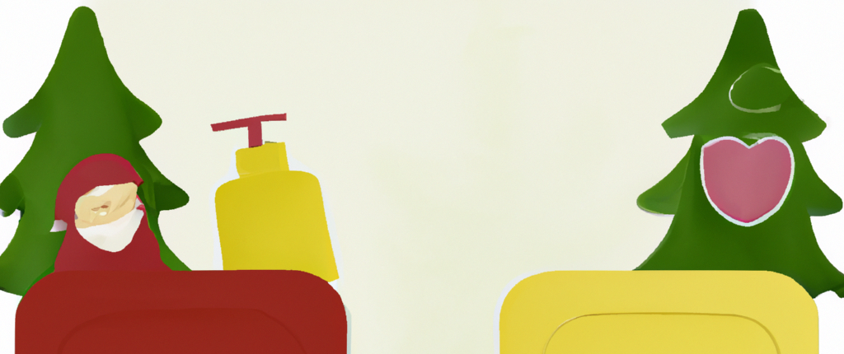
Stained shirt in the sink
Brings back memories of that drink
Washed away now clean
Soap in the shower, slip
I almost fell, but I grip
Leaves me feeling clean and hip
Soap on my face, scrub
Removing dirt and grime, I dub
Myself the queen of the tub
The scent of soap fresh
Bringing memories of my ex
I wash away the stress
Stained shirt in the sink
Brings back memories of that drink
Washed away now clean
Soap, soap, my shower nemesis
Slippery and slimy, hard to hold
Why must you haunt me?
Soap, soap, my daily foe
Never ends the constant scrubbing
Feeling like a prune
Lather, Rinse, Repeat:
ChatGPT's Soapy Haikus
Lather, Rinse, Repeat:
ChatGPT's Soapy Haikus
Lather, Rinse, Repeat:
ChatGPT's Soapy Haikus
Lather, Rinse, Repeat:
ChatGPT's Soapy Haikus

